Slide 1

VETRI VINAYAHA COLLEGE OF ENGINEERING AND TECHNOLOGY
ANNA UNIVERSITY : CHENNAI OCT 2023

Slide 2
SUBMITTED BY
NITHOSHKUMAR N 623320104015
VETRIAZHAGAN S 623320104026
BHARANIKA 623320104005
Guided by
Mr .P. SURIYA
AP/CSE

Slide 3
ETHEREUM DECENTRALISED IDENTIFY SMART CONTACT

Slide 4
INTRODUCTION
In a digital landscape where privacy and security are paramount, Ethereum's decentralized identity smart contracts emerge as guardians of personal information.
These smart contracts, residing on the Ethereum blockchain, revolutionize the way we manage and authenticate identity.
Imagine a world where your identity isn't confined to centralized databases vulnerable to breaches.
These contracts, built on Ethereum's robust blockchain, ensure transparency, immutability, and security.

Slide 5
EXISTING SYSTEM
uPort is a decentralized identity platform that leverages Ethereum smart contracts to provide users with control over their digital identities.
In the uPort ecosystem, individuals create their self-sovereign identities, which are secured by private keys stored on their devices. These identities are then anchored on the Ethereum blockchain through smart contracts, ensuring immutability and transparency.
Users have the authority to selectively share their identity attributes, granting them granular control over the information they disclose.
The uPort system goes beyond traditional identity management by enabling users to seamlessly interact with decentralized applications (DApps) and services. This integration allows for a unified and secure user experience across the Ethereum ecosystem.

Slide 6
EXISTING SYSTEM DISADVANTAGE
Scalability Concerns: Ethereum, as of now, faces scalability issues, leading to network congestion and higher transaction costs..
User Adoption: The concept of self-sovereign identity and managing cryptographic keys can be complex for non-technical users. Achieving widespread adoption requires user-friendly interfaces and educational efforts to make the process more accessible.
Privacy Challenges: Despite being more private than traditional identity systems, blockchain transactions are still visible on the public ledger. Striking a balance between transparency and privacy remains a challenge, especially when dealing with sensitive identity information.
Regulatory Uncertainty: The regulatory landscape surrounding decentralized identity is still evolving..

Slide 7
PROPOSED SYSTEM
Ethereum decentralized identity smart contracts envisions a seamless and user-centric approach to identity management. Leveraging the Ethereum blockchain, the system would integrate advanced cryptographic techniques to ensure secure, transparent, and tamper-proof storage of personal information.
Smart contracts would empower individuals with self-sovereign control over their identities, allowing selective disclosure of information for various transactions and interactions.
The proposed system would prioritize user-friendly interfaces and educational initiatives to enhance adoption, while ongoing developments in blockchain scalability and interoperability would address current limitations.
Privacy measures, compliant with evolving regulations, would be central to the design, offering a fine balance between transparency and protection.

Slide 8
PROPOSED SYSTEM ADVANTAGE
By leveraging blockchain technology, it ensures unparalleled security through cryptographic principles, protecting user identities from unauthorized access.
The self-sovereign nature of the system empowers individuals with greater control over their personal information, fostering privacy and reducing reliance on centralized authorities. Seamless integration with decentralized applications enhances user experiences, while ongoing developments in blockchain scalability and interoperability address current limitations, promoting widespread adoption.
The transparent and tamper-proof nature of the Ethereum blockchain ensures the immutability of identity data, establishing a trustworthy foundation for digital interactions.
This proposed system, with its emphasis on security, user control, and technological advancements, holds the potential to redefine and elevate the landscape of decentralized identity solutions.

Slide 9
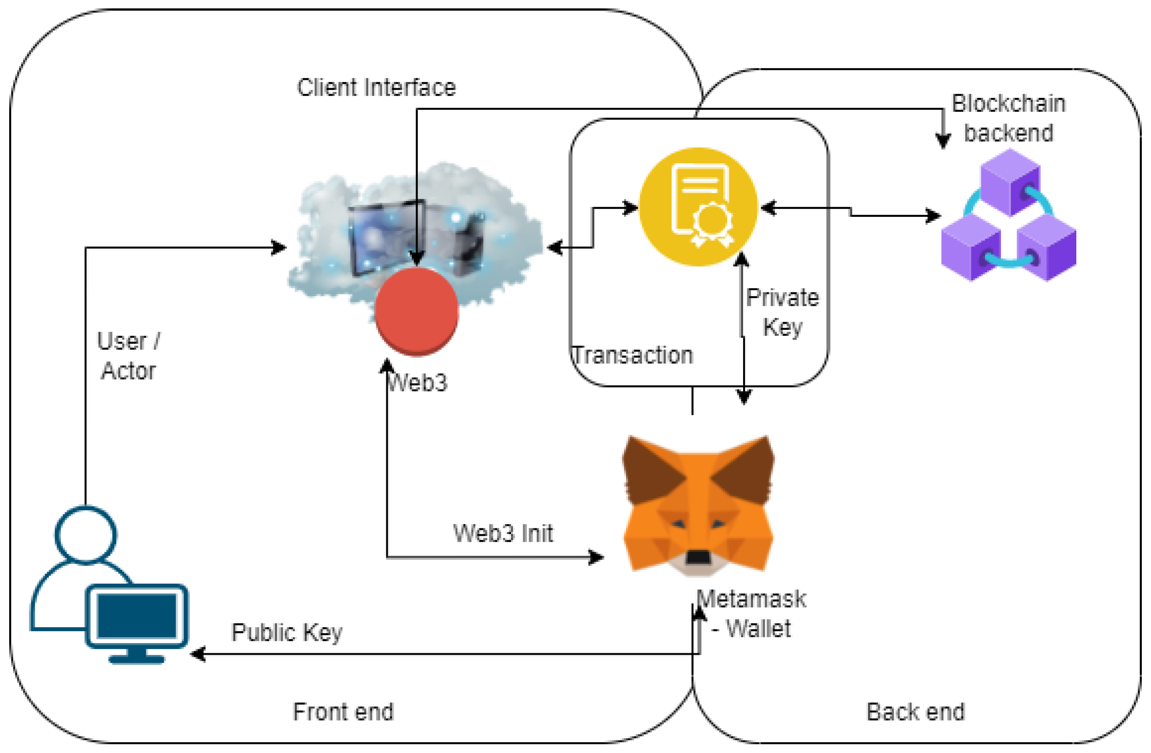
ARCHITECTURE

Slide 10
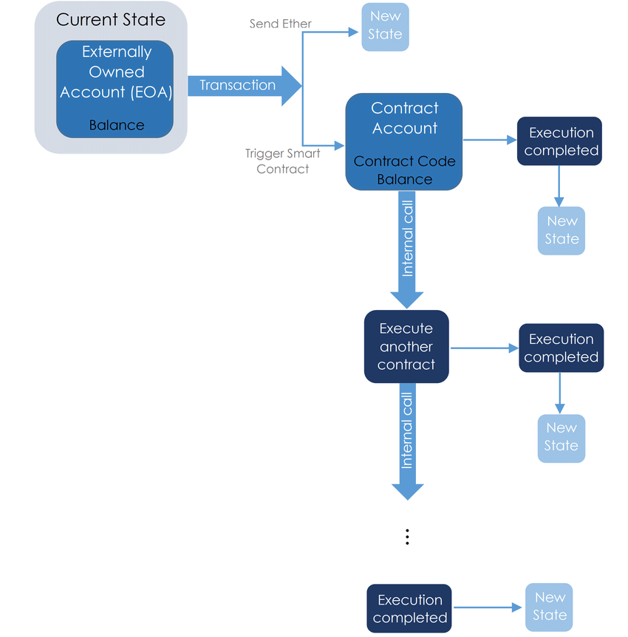
FLOW DIAGRAM

Slide 11
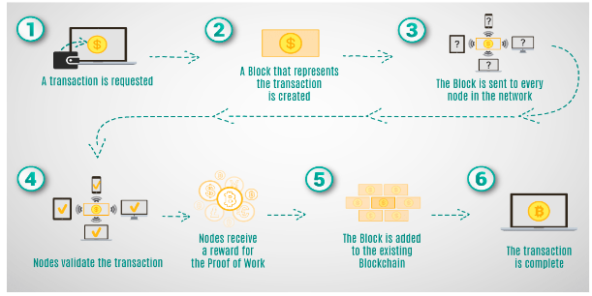
PROJECT PLANNING

Slide 12
CONCLUSION
the Ethereum decentralized identity smart contract project represents a transformative leap in how we approach identity management in the digital realm. By harnessing the power of blockchain and smart contracts, this system addresses the shortcomings of centralized models, offering enhanced security, user control, and privacy.
The self-sovereign nature of identities, coupled with advancements in blockchain scalability and interoperability, positions this project at the forefront of a more inclusive and user-friendly digital future.
As regulatory frameworks evolve and technological innovations continue, the proposed system stands as a testament to the potential for decentralized identity solutions to redefine trust, transparency, and individual empowerment in the digital age.
While challenges exist, the trajectory of this project holds promise for reshaping our understanding and implementation of identity in the decentralized landscape.

Slide 13
FUTURE SCOPE
As blockchain technology continues to advance, scalability issues are likely to be addressed, fostering the integration of decentralized identity solutions on a larger scale.
Interoperability standards may emerge, enabling seamless communication between various decentralized identity platforms and enhancing user accessibility.
Continued collaboration with regulatory bodies may establish a clear framework for compliance, facilitating widespread adoption across industries. Moreover, the integration of advanced technologies like zero-knowledge proofs and identity-focused consensus mechanisms could further enhance the privacy and security features of the system..

Slide 14
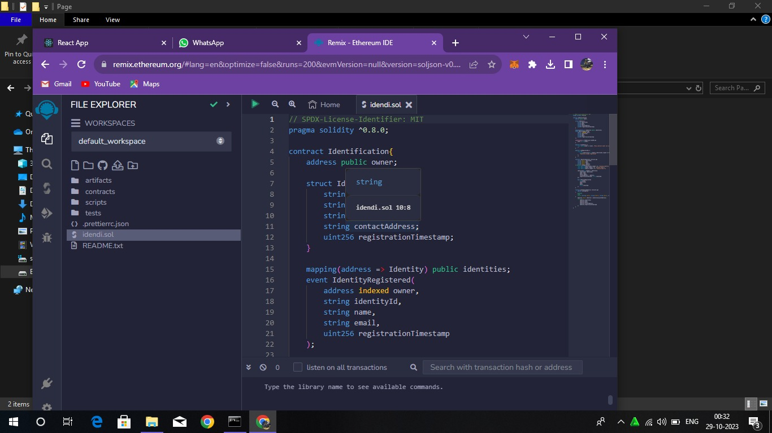
OUTPUT

Slide 15
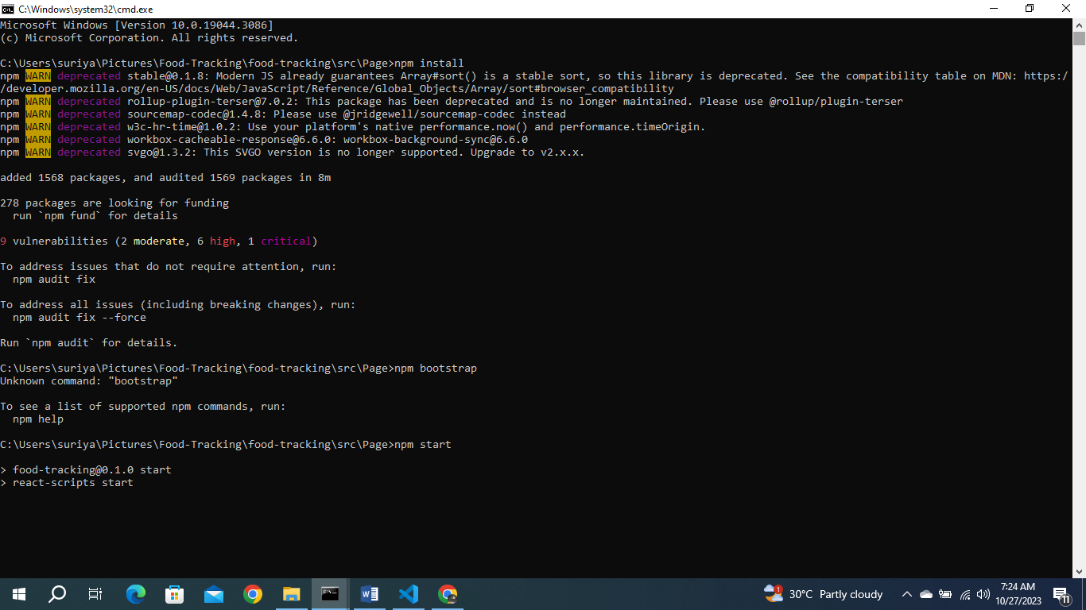

Slide 16
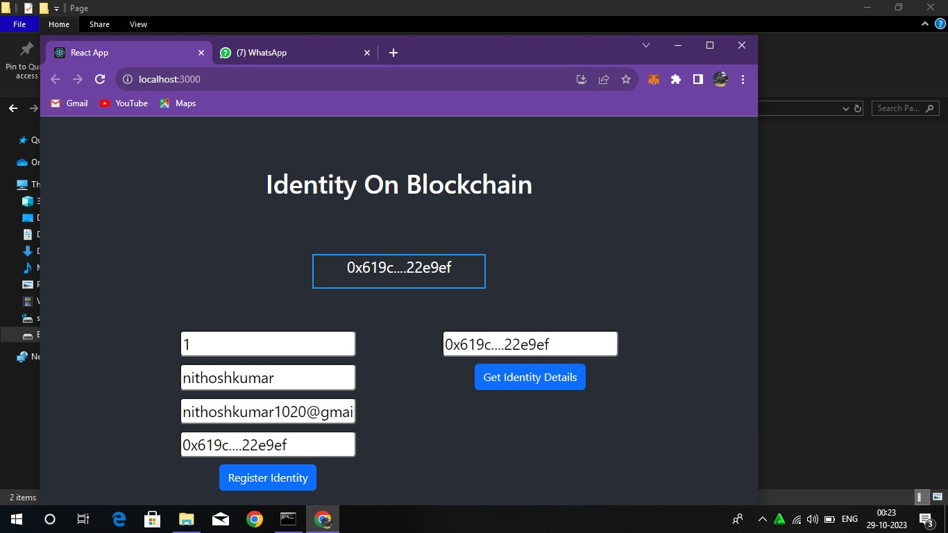

Slide 17


